Slide 1


MME(Meetings Made Easy)
SHRI RAMDEOBABA COLLEGE OF ENGINEERING AND MANAGEMENT, NAGPUR
Department of Information Technology
Sem-VII (2021-22)
Project Seminar on
by
Aman Shah(27)
Arjun Thakur(33)
Vineet Pashine(69)
Under the guidance of
Pratibha Kokardekar
Assistant Professor, IT Deptt. RCOEM, Nagpur

Slide 2
Contents
Project Definition
Introduction
Literature Review
Methodology
Applications
Timeline
Current Status
References

Slide 3
Project Definition
This project is about saving time and resources, by automating the process involved in creating minutes of meeting and audio summarization from Google meet using Natural Language Processing and Machine learning techniques .

Slide 4
Introduction
Meeting minutes are time consuming,distarcting and boring
Organizations spend roughly 15% of their time on meetings, with surveys showing that 71% of those meetings are considered unproductive. [1]
An estimated $37 billion is lost per year to unproductive meetings.
24 billion hours are wasted each year as the result of unproductive meetings. [1]
This project will ensure that the user have his whole attention on the meeting rather than noting the minutes of meeting.

Slide 5
Literature Review
Sr. No | Paper | Author | Description
1. | A Review Paper on Text Summarization (International Journal of Advanced Research in Computer and Communication Engineering Vol. 5, Issue 3, March 2016) | Deepali K. Gaikwad C. Namrata Mahender | It describes the text summarization and its different approaches extractive based approach, abstractive summarisation approach etc.
2. | Exploring the Limits of Transfer Learning with a Unified Text-to-Text Transformer | Colin Raffel Noam Shazeer Adam Roberts Katherine Lee | It discusses about the working and implementation of T-5 model and its application describing through its various methods and examples
3. | An Interpretation of Lemmatization and Stemming in Natural Language Processing (Journal of University of Shanghai for Science and Technology) | Divya Khyani, Siddhartha, Niveditha N M, Divya B M, | This paper provides brief idea about methods such as Lemmatization and stemming.

Slide 6
Methodology
The following methodology are used
Convert meeting to a textual format by capturing [cc] or by using speech recognition
The entire text will be summarized based on pretrained ML model, NLTK library, and NLP to give us well- documented Minutes Of Meeting
The backend of the project will allow converting the summarized text to multilingual languages, to remove the barrier of English.
The backend will convert the summarized text to audio form thus providing help to visually impaired people.

Slide 7
Applications
Save times on board meetings team management and customer support so that user has efficiency in his work
Transcription of Meeting: Convert meeting into textual format
Summarization of Text: The entire meeting transcript is summarized to give well-documented minutes of meeting
Translation into multiple languages: Summarized text will be available in languages.
Text to Speech Conversion: Summarized text can be converted to audio, which will be helpful for visually challenged people.

Slide 8
Time Line
VII Sem
Creating django backend
Working with REST framework
Summarization implementation
Translation of summarization to other language
Text to voice conversion
Dashboard and frontend to see text summarization or hear voice summarization
Integrating with chrome extension

Slide 9
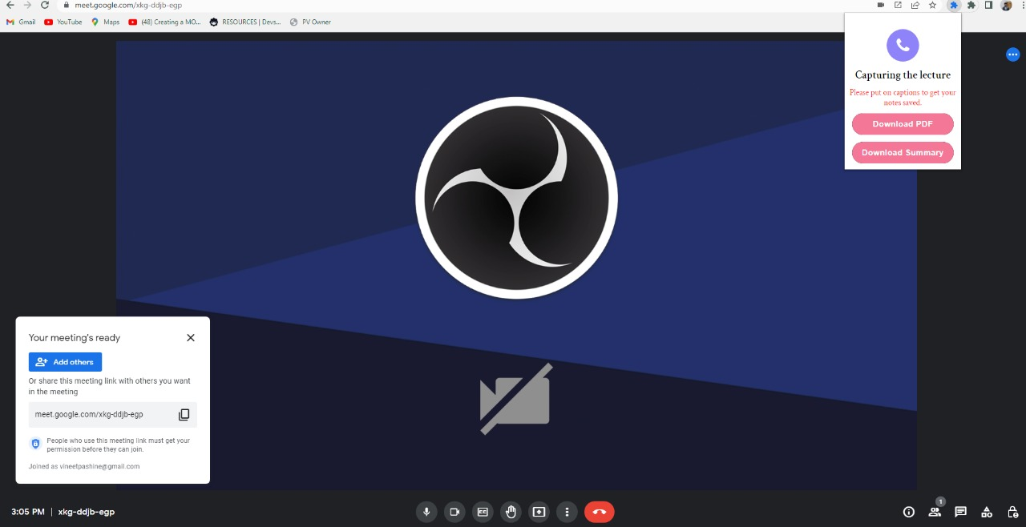
Current Status

Slide 10
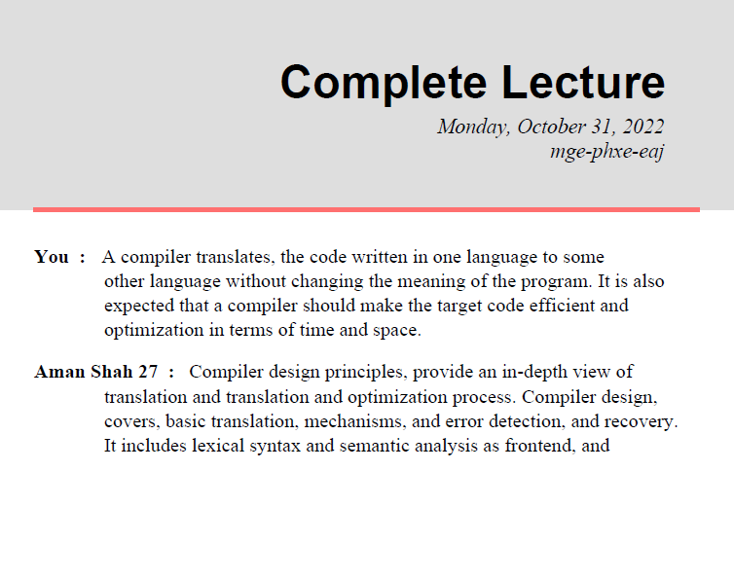
Current Status

Slide 11
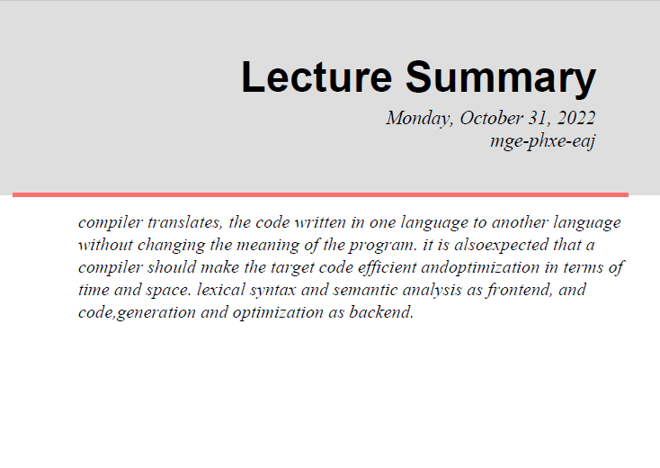
Current Status

Slide 12
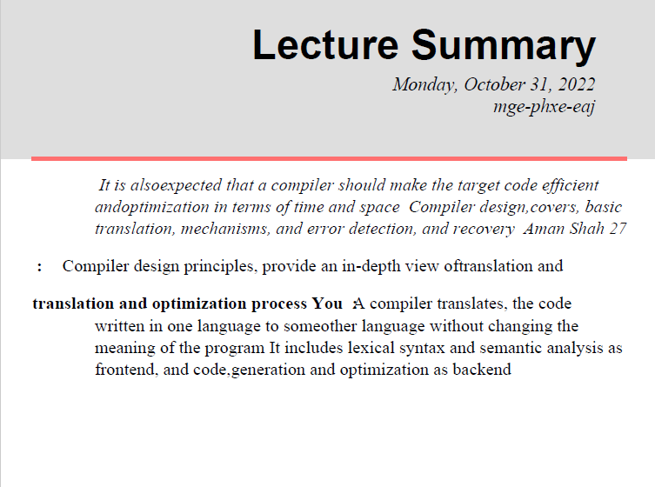
Current Status

Slide 13
References
[1] https://www.zippia.com/advice/meeting-statistics/
Detection of leaf disease and classification using digital image processing, R. Meena Prakash, G.P. Saraswathy , G. Ramalakshmi
A review paper on text summarization, Deepali K. Gaikwad and C. Namrata Mahender
An Interpretation of Lemmatization and Stemming in Natural Language Processing, Divya Khyani, Siddhartha, Niveditha N M,Divya B M
[2]https://www.sciencedirect.com/science/article/abs/pii/S0957417421015979

